Slide 1



Profile
Zendi Iklima
zendi.Iklima@mercubuana.ac.id
TEKNIK
Teknik Elektro

Slide 2
Rules
PK2_T1_Nama_NIM (30%)
PK2_Q1_ Nama_NIM
PK2_UTS_Nama_NIM (30%)
PK2_UAS_ Nama_NIM (30%)
ke: zendi.Iklima@mercubuana.ac.id

Slide 3
Educations
Strata 1 (S1) Teknik Elektro (SC, Robotics, Android)
Universitas Mercu Buana (2011-2014)
Strata 1 (S1) Teknik Informatika
(SC&M, Robotics, Android)
Universitas Esa Unggul (2011-2015)
Strata 2 (S2) Software Engineering
(DA, ML, SC&M, Dig.Proc, Native, Robotics)
Beijing Institute of Technology (2016-2018)

Slide 4
Computer
Programming Adv
01
Introduction
TEKNIK
TEKNIK ELEKTRO
Zendi Iklima ST, SKom, MSc
Notes:
https://becoming-functional.com/a-brief-history-of-programming-c13d87b79337
https://en.wikipedia.org/wiki/History_of_programming_languages
https://en.wikipedia.org/wiki/Computer_programming

Slide 5
A program is a set of instructions written in a language (such as BASIC) understandable by the computer to perform a particular function on the computer. A well written program could be parceled well to form an application package customized for solving specific type of problem on the computer system
USMAN O.L., OWOADE A.A., ABIMBOLA B.L., & OGUNSANWO G.O.INTRODUCTION TO COMPUTER PROGRAMMING:2016

Slide 6
A computer programmer is computer scientist (a professional) skilled in using constructs of programming languages to develop executable and acceptable computer programs. A software developer is a programmer. Programmers often work hand in hand with system analysts on large projects.
USMAN O.L., OWOADE A.A., ABIMBOLA B.L., & OGUNSANWO G.O.INTRODUCTION TO COMPUTER PROGRAMMING:2016

Slide 7
Programming languages are artificial notational languages created or developed to be used in preparing coded instructions on the computer for later execution by the computer. They are usually composed of series of usage rules (syntax) that determine the meaning (semantics) of expressions written in the language. Each programming language comes handy with its own translator i.e interpreter or compiler as the case may be.
USMAN O.L., OWOADE A.A., ABIMBOLA B.L., & OGUNSANWO G.O.INTRODUCTION TO COMPUTER PROGRAMMING:2016

Slide 8
Programming is the art of developing computer programs with the aid of selected programming language by a computer programmer. It is a special skill whose quality is tested by the quality of the resulting program or software. In programming, programming stages must be properly followed, i.e from problem definition to maintenance and review
USMAN O.L., OWOADE A.A., ABIMBOLA B.L., & OGUNSANWO G.O.INTRODUCTION TO COMPUTER PROGRAMMING:2016

Slide 9
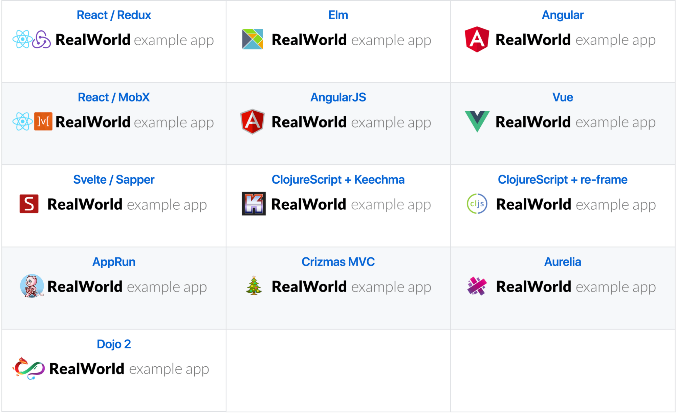
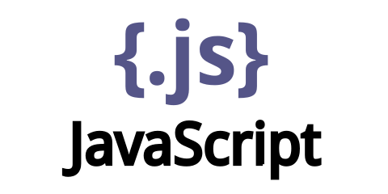

Slide 10
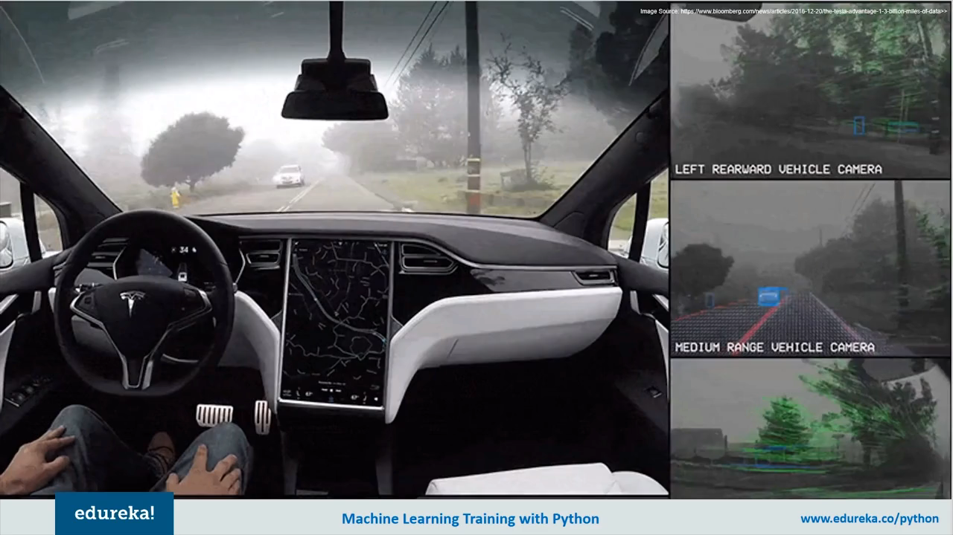

Slide 11
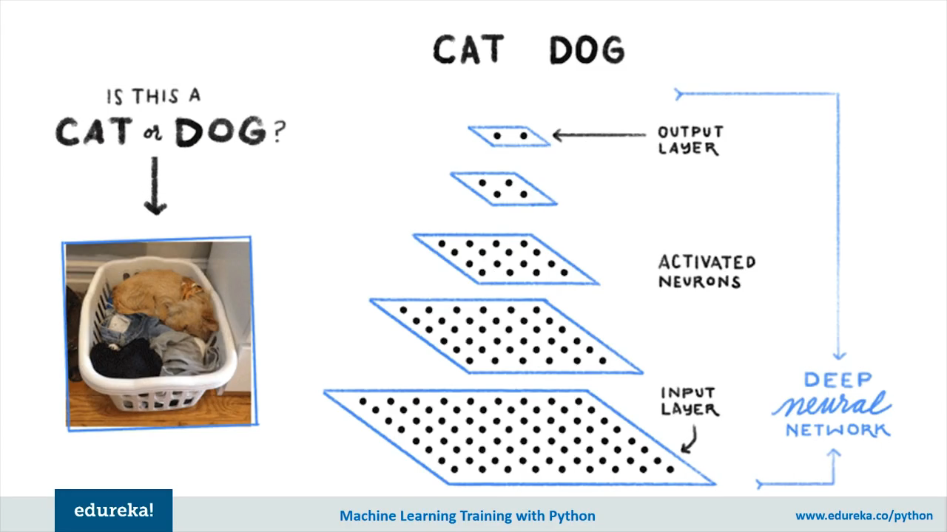
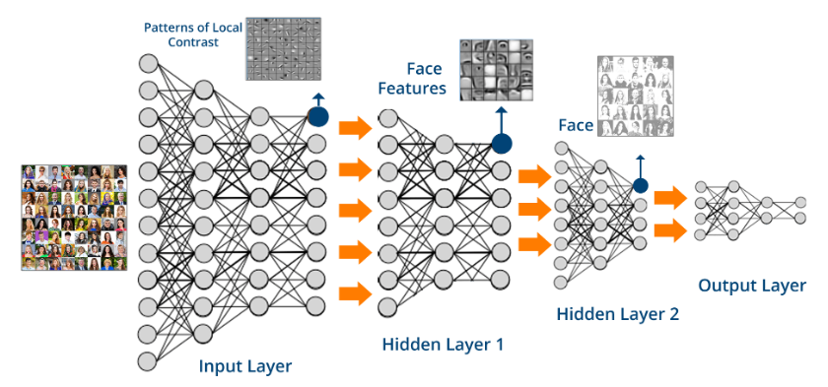

Slide 12
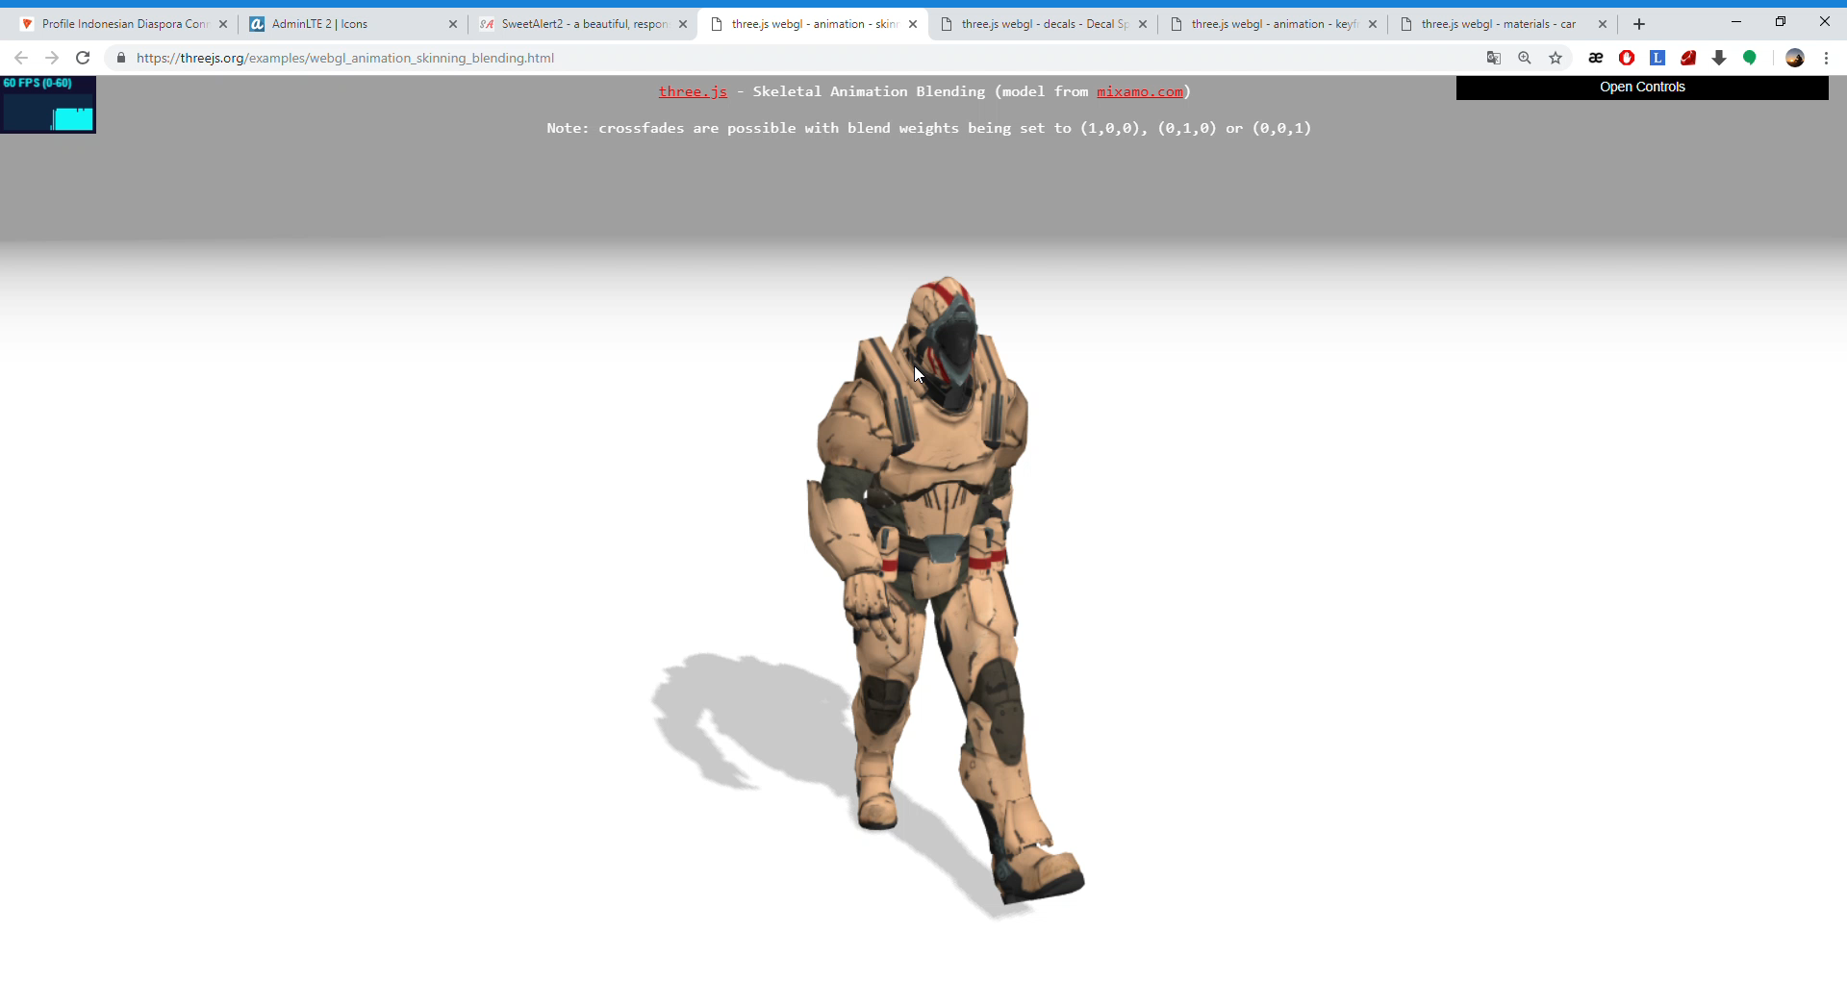

Slide 13
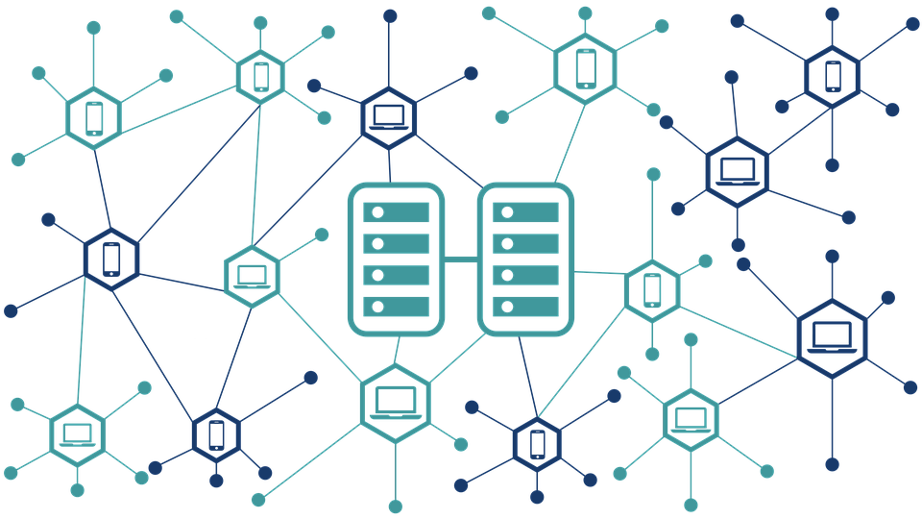


Slide 14
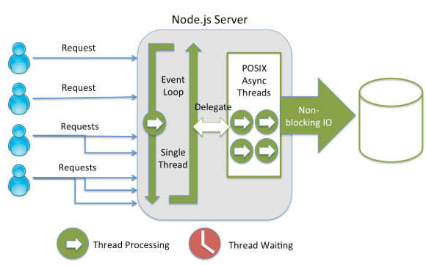
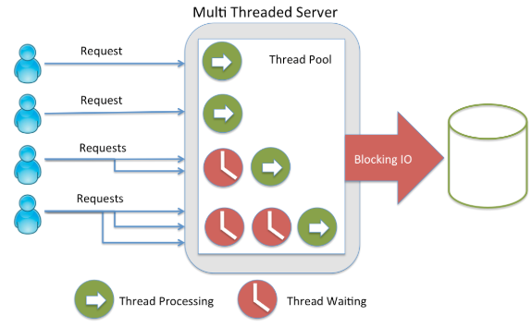

Slide 15
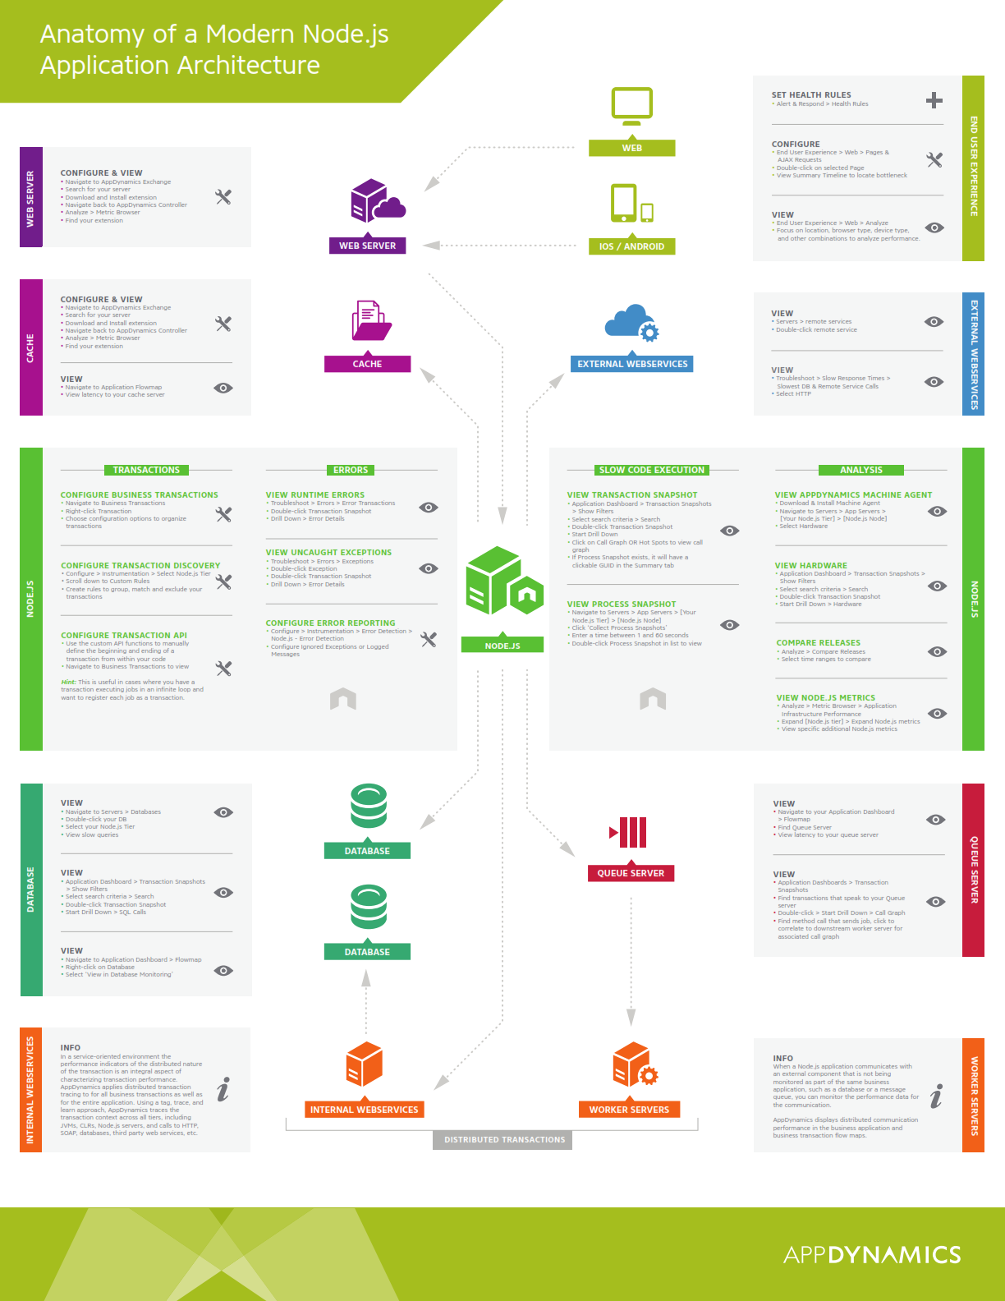

Slide 16
Outlines
Basic of Javascript
Operators of Javascript
Functions and Logics
Math in JavaScript
JavaScript Frameworks
Rest API by ExpressJS and Cloud Firestore
Bootstrapping
WebSocket WorkFlow
Basic ChatBot (by Own Frameworks)
ChatBot with Ardunio
AI in JavaScript

Slide 17
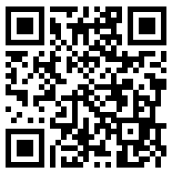


Slide 18
Zendi Iklima ST, SKom, MSc

